Slide 1

IMPACT OF TRANSFORMATIONAL AND SERVANT LEADERSHIP ON ORGANIZATIONAL PERFORMANCE:
A COMPARATIVE ANALYSIS
Authors: Ali Iftikhar Choudhary, Syed Azeem Akhtar & Arshad Zaheer

Slide 2
PRESENTED BY:
Azman Shakir 2021-CS-176
Laiba Arif 2021-CS-173
Saqib Shahzad 2021-CS-187
Nasir Kamal 2021-CS-192
PRESENTED TO:
Ms. Samina Yaqub

Slide 3

AGENDA
Introduction
Methodology
Analysis & Findindgs
Conclusions

Slide 4

Introduction
01
02
Impact & Purpose
Research Objectives
03
04
Transformational Leadership
Impact of Transformational Leadership

Slide 5
Introduction
Significance of Leadership in Organizations
Leadership shapes organizational culture, performance, and employee engagement.
Different leadership styles influence decision-making and productivity
Why Leadership Styles Matter?
Impact employee motivation, retention, and innovation.
Influence workplace culture and long-term growth

Slide 6
Research Objectives
Why This Study?
Explore leadership’s role in organizational performance.
Assess how organizational learning mediates leadership effectiveness.
Key Research Questions:
Which leadership style best enhances performance?
How does organizational learning influence leadership effectiveness?
How do Transformational & Servant Leadership differ in impact?

Slide 7
Transformational Leadership
A leadership style that inspires and motivates employees to exceed expectations.
Focuses on vision, innovation, and personal growth.
Key Components:
Idealized Influence – Leaders act as role models with strong ethics and vision.
Individualized Consideration – Provide personalized support and mentorship.
Intellectual Stimulation – Encourage innovation and critical thinking.

Slide 8
Impact of Transformational Leadership
Drives Innovation – Encourages employees to think creatively.
Boosts Engagement – Creates a culture of trust and motivation.
Promotes Learning – Fosters continuous skill development.
Improves Efficiency – Aligns employees with organizational goals.

Slide 9
Servant Leadership
A leadership style where leaders prioritize serving employees before leading.
Focuses on employee well-being, growth, and ethical leadership.
Introduced by Robert Greenleaf (1977), emphasizing service over authority.
Encourages trust, teamwork, and personal development to enhance performance.

Slide 10
Impact of Servant Leadership
Builds a trustworthy and ethical workplace, improving employee satisfaction.
Encourages open communication, boosting teamwork and engagement.
Increases employee retention and motivation, leading to higher productivity.
Motivates a culture of knowledge-sharing and collaboration.
Leads to sustainable business growth and customer satisfaction.

Slide 11
Aspect | Servant Leadership | Transformational Leadership
Focus | Employee well-being | Vision & organizational goals
Approach | Service-oriented | Inspiration & motivation
Primary Goal | Employee development | Organizational success
Leadership Style | Supportive & humble | Visionary & charismatic
Transfor-
mation
VS
Servant Leadership

Slide 12
Organizational Learning
A process of learning, sharing, and using knowledge to do better work.
Helps companies adjust to change, create new ideas, and stay successful.
Encourages teamwork and sharing knowledge to make better decisions.
Improves employee skills, job happiness, and work efficiency.

Slide 13
Why Organizational Learning is Important
Helps employees grow
Learning new skills improves performance.
Encourages new ideas
Innovation helps the company stay ahead.
Improves teamwork
Sharing knowledge builds a stronger team.
Prepares for change
Companies that learn can adapt quickly.

Slide 14
Research Hypothesis
H1
H3
Transformational leadership is positively related to organization learning.
Organizational learning helps companies perform better.
H2
Servant leadership improves learning by creating a safe, supportive environment.

Slide 15
Methodology
Purpose: Analyze leadership impact on organizational performance
Target Population: Employees from hotels, telecom, and banking sector in Pakistan
Research Approach: Quantitative, survey-based study
Data Collection: Structured questionnaire
Sample Size: 400 approached, 155 valid responses
Analysis Tools: SPSS & AMOS used for data processing

Slide 16
Sampling & Scale
Sampling Method: Non-probability judgment sampling (Experts & professionals selected)
Measurement Scale: Five-point Likert scale (1-Strongly Disagree to 5-Strongly Agree)
Scales Used:
Transformational Leadership – 4 items adapted from Morales et al. (2008)
Servant Leadership – 9 items taken from Jacobs (2006)
Organizational Learning – 4 items from Morales et al. (2008)
Organizational Performance – 4 items from Morales et al. (2008)

Slide 17
Analysis & Discussion
Key Findings:
Both leadership styles improve organizational learning
Transformational Leadership has a stronger impact than Servant Leadership
Organizational learning directly improves performance
Correlation Results:
TL & Organizational Learning: 0.664 (Moderate Positive)
SL & Organizational Learning: 0.580 (Moderate Positive)
OL & Performance: 0.617 (Strong Positive)

Slide 18
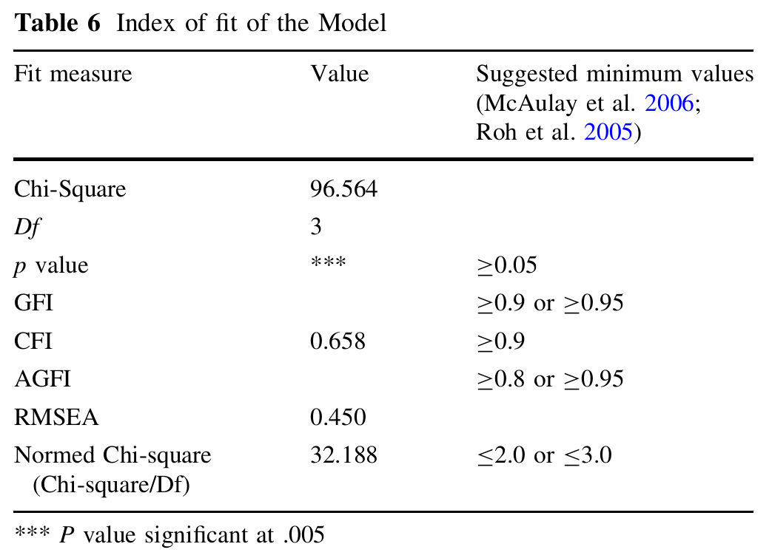
AMOS software tested the research model.
Model fit indices:
Chi-square = 96.564, DF = 3, p < 0.005.
RMSEA = 0.450, CFI = 0.658 (below recommended thresholds).
Hypotheses tested using regression weights.
Model Fit & Hypothesis Testing

Slide 19
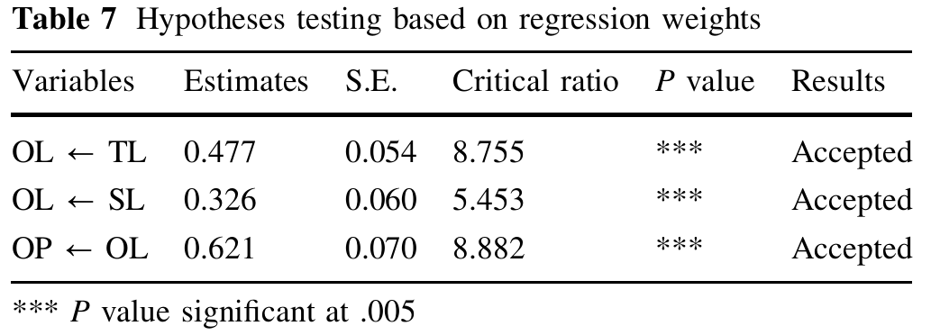
H1: Transformational Leadership → Organizational Learning (β = 0.477*).
H2: Servant Leadership → Organizational Learning (β = 0.326*).
H3: Organizational Learning → Organizational Performance (β = 0.621*).
Transformational Leadership has a stronger impact than Servant Leadership.
Hypothesis Results

Slide 20
Key Findings
Transformational Leadership (TL) boosts Organizational Learning (OL) more than Servant Leadership (SL).
OL directly improves Organizational Performance (OP).
Managers should prioritize TL to maximize profitability.
Conclusion
Recommendations
Train leaders in TL techniques (e.g., inspiring teams, setting clear goals).
Foster a learning culture to enhance performance.

Slide 21
Key Limitations
Sample limited to profit-oriented service sectors (e.g., hotels, banks).
Not applicable to non-profits, manufacturing, or public sectors.
Small sample size (155 respondents) and Pakistan-specific context.
Limitations & Future Research
Opportunities
Test TL and SL in manufacturing, healthcare, or non-profits.
Explore links between leadership styles and innovation/employee engagement.
Expand sample size and cultural contexts (e.g., Western countries).

Slide 22
Thank You

